Slide 1
Meme Review:
Dead or Alive?
Predicting Reader Response to Timely Memes using Machine Learning

Slide 2
Contributors
Abir Rahman
Jawad Aziz Khan
Taufiq Rahman

Slide 3

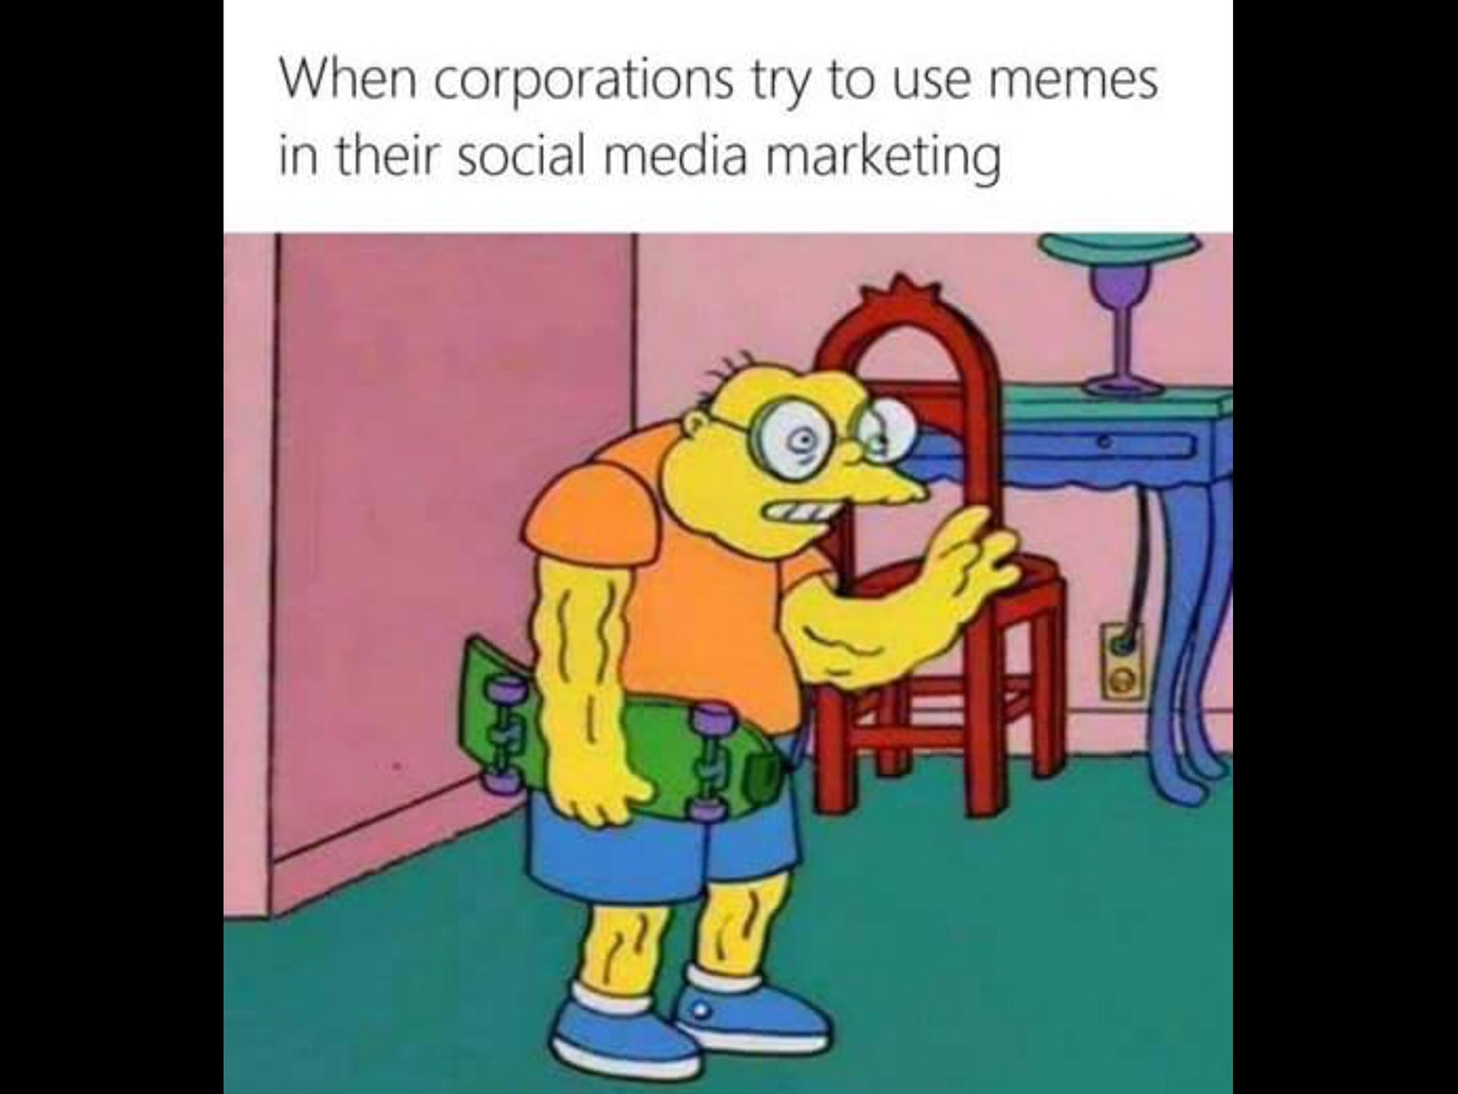
Motivation & Problem Definition Recap
2 out 5 Facebook posts are memes
Memes are a great marketing tool
Millennials love memes
Online Businesses and Influencers
Massive Data dump

Slide 4
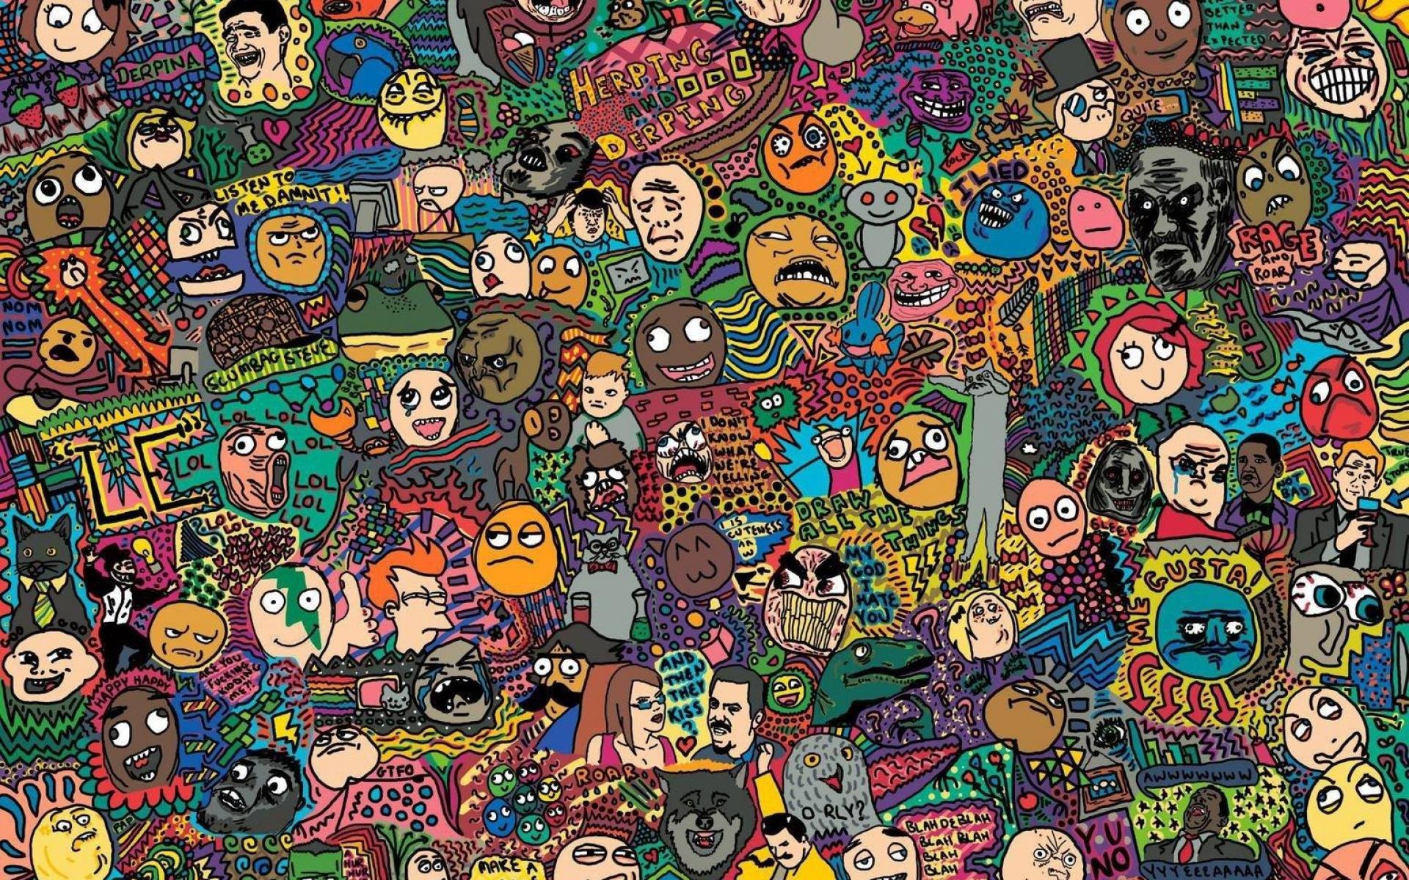
Background
What is a Meme?
History of Memes
What does Memes have to do with Machine Learning?

Slide 5
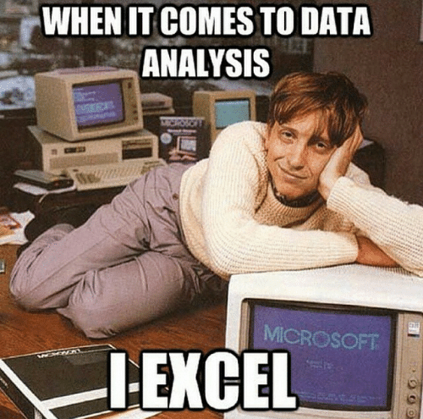
Data Source
Kaggle
Reddit meme dump
JSON metadata

Slide 6
Pre-processing
Resolution Resize
Convert JSON metadata
AlphaNumeric IDs
UNIX-based UTC Timestamp

Slide 7

ML Algorithms
Inception
AlexNet
VGGnet

